Slide 1
IPL Tableau visualization

Slide 2
AGENDA
Creating an interactive and visual dashboard that highlights essential statistics of IPL over the years.

Slide 3
Introduction
We were presented with 2 data sets with information pertaining to the Matches and Deliveries of each batsman, bowler, and team across each season from 2008 to 2017. By combining these two data sets, we have collectively designed a tableau workbook along with 3 dashboards namely, Match Statistics, Team Statistics, and Player statistics.

Slide 4
Match statistics
Toss outcome vs Match outcome (for each Ground/Venue)
Biggest wins (by runs and by wicket)
Highest totals (across all the seasons)

Slide 5
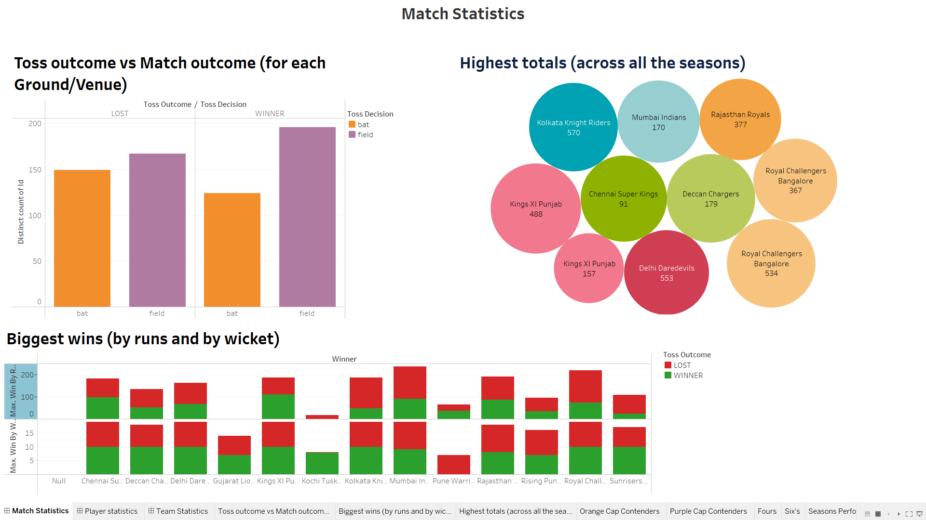
Match Statistics Dashboard

Slide 6
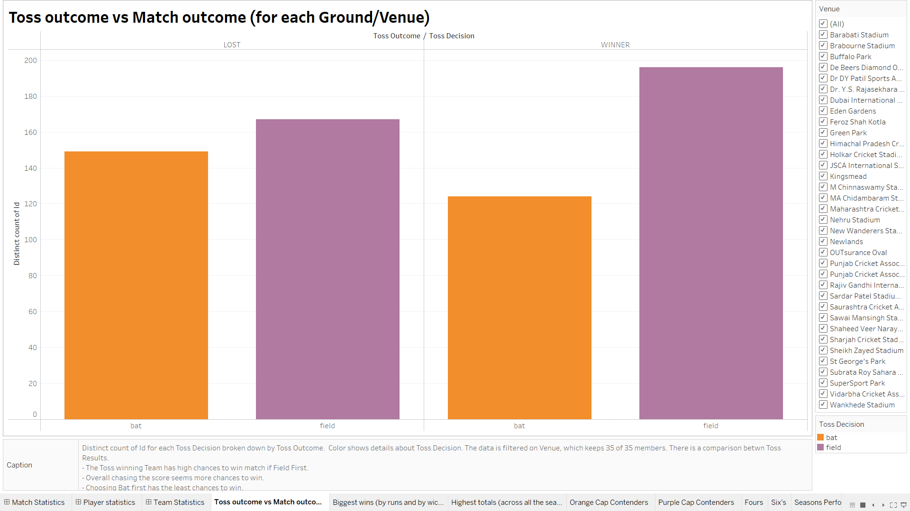
Toss outcome vs match outcome – Based on venue and ground
The distinct count of Id for each Toss Decision is broken down by Toss Outcome. The color shows details about Toss Decision.
The data is filtered on Venue which includes 35 places. There is a comparison between Toss Results.
The Toss winning Team has a high chance to win the match if Field First.
We notice that those who got to Bat first has the least chance to win.

Slide 7
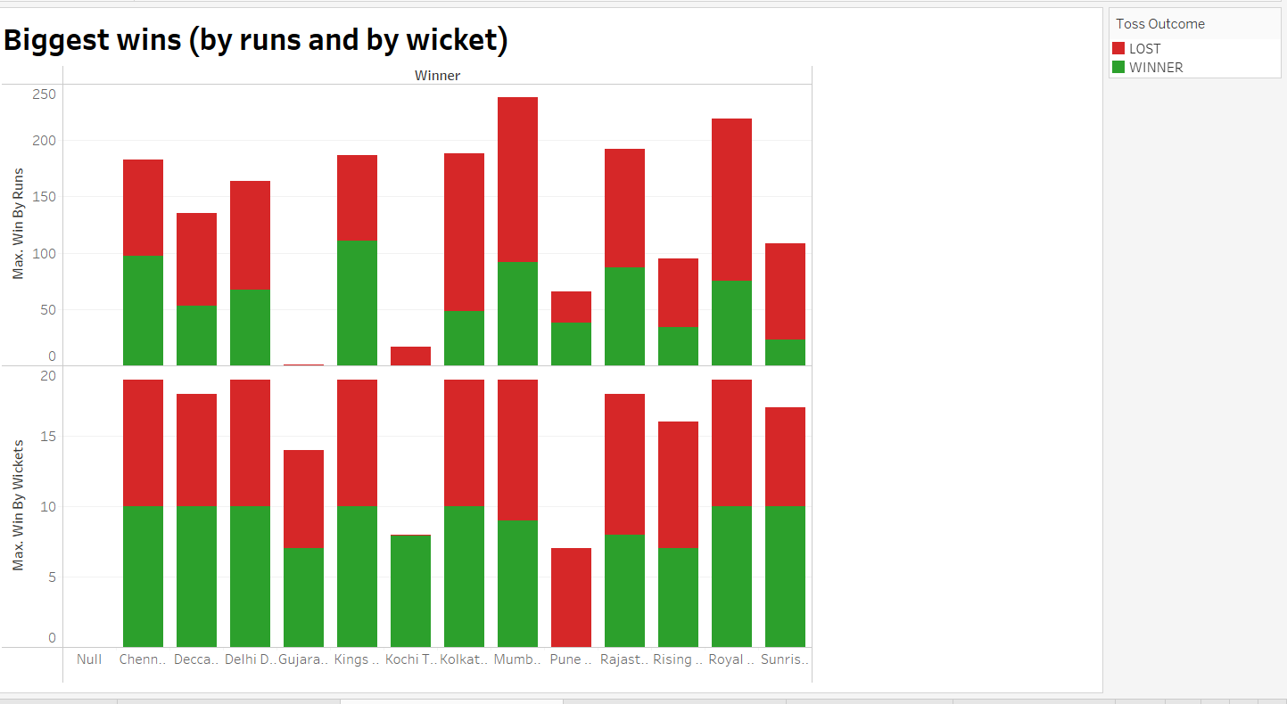
Biggest wins by runs and wickets
Maximum matches won by respective runs and wickets are calculated and visualized.
Matches lost are depicted in red whereas matches won are depicted in green.
The data is filtered based on the total outcome of each match played during each season.

Slide 8
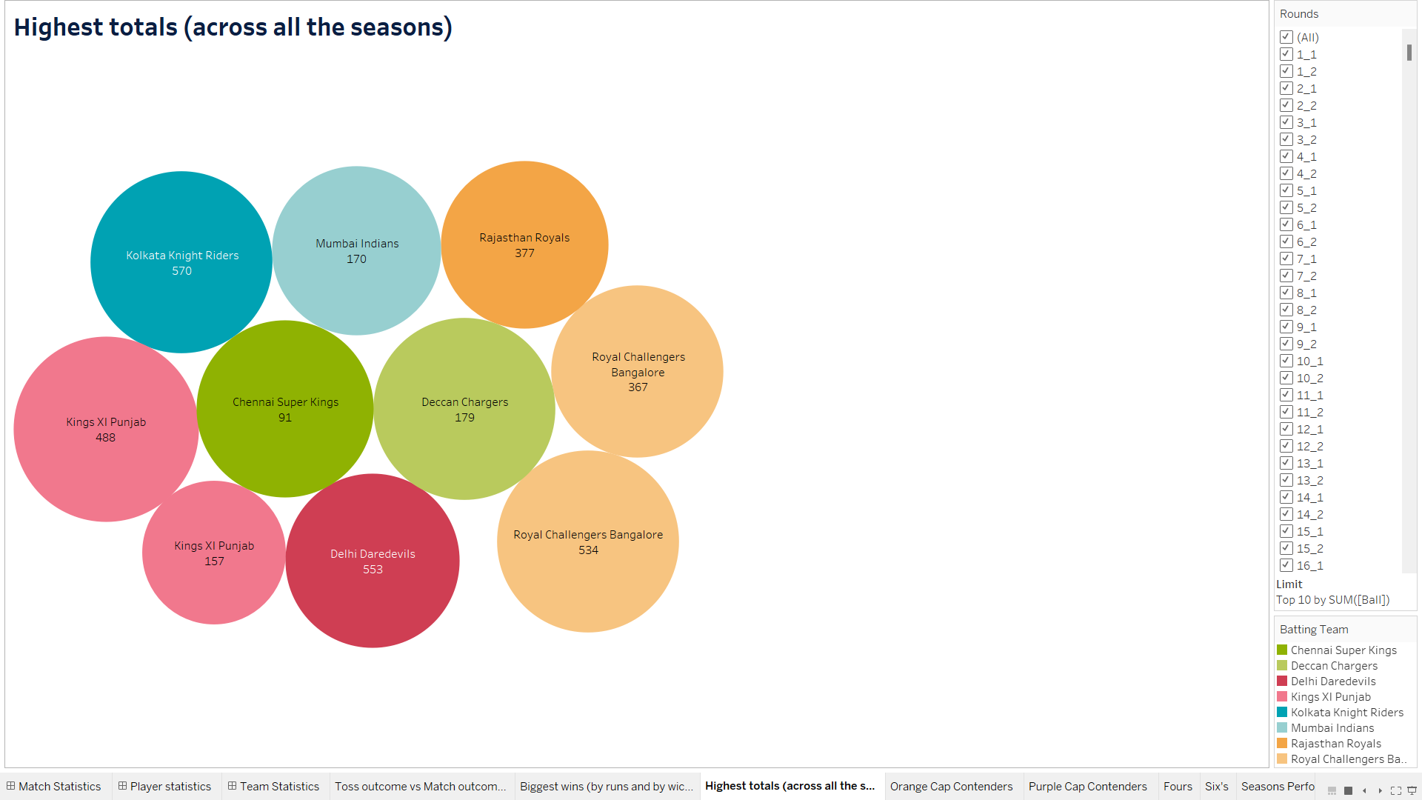
Highest totals across all seasons
The visualization depicts the highest totals of each team across each season.
The distinctive color shows details about Batting Team and the Size shows the sum of Total Runs.
The marks are labeled by Batting Team and Match Id. The data is filtered on Rounds, which keeps 10 of 1,284 members.
We understand through the visualization the Kolkata Knight Riders is trailing at the highest with 570.

Slide 9
player statistics
Orange Cap contenders (The batsmen who have scored the maximum number of runs in a season)
Purple Cap contenders (The bowlers who have taken the maximum number of wickets in a season)
Batsmen who have hit the most number of fours and sixes (per season and overall)

Slide 10
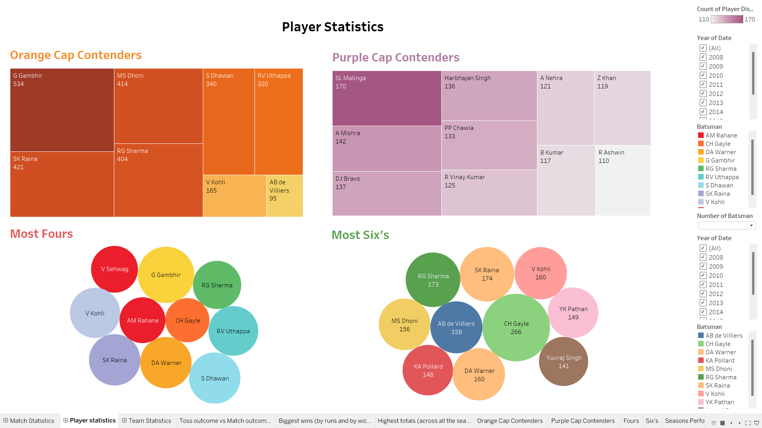
player Statistics Dashboard

Slide 11
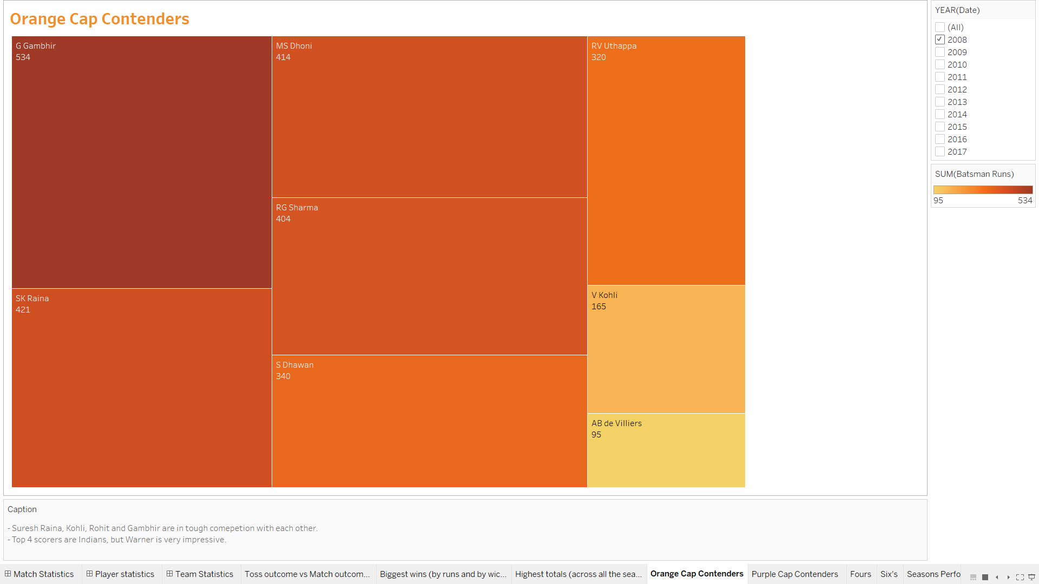
ORANGE CAP CONTENDERS – BATSMEN SCORING HIGHEST RUNS DURING A PARTICULAR SEASON
The visualization represents the batsmen who have scored the highest number of runs during a particular season from 2008 to 2017.
The data is filtered based on year.
The title is named orange cap contenders and we have used a treemap in the color orange to depict the highest performers.
Gautam Gambhir is the best performer with 534, and Suresh Raina and Rohit Sharma are in tough competition.

Slide 12
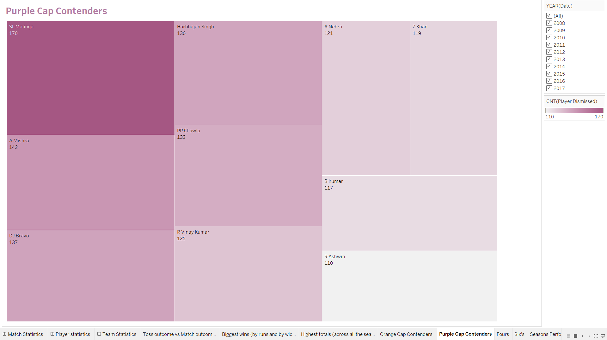
PURPLE CAP CONTENDERS – BOWLERS TAKING THE HIGHEST WICKETS DURING A PARTICULAR SEASON
The visualization represents the bowlers who have taken the highest number of wickets during a particular season from 2008 to 2017.
The data is filtered based on the year and total wickets.
The title is named purple cap contenders and we have used a treemap in the color purple to depict the highest performers.
SL Malinga is the best performer with 170 with Mishra and Harbhajan competing for the same.

Slide 13
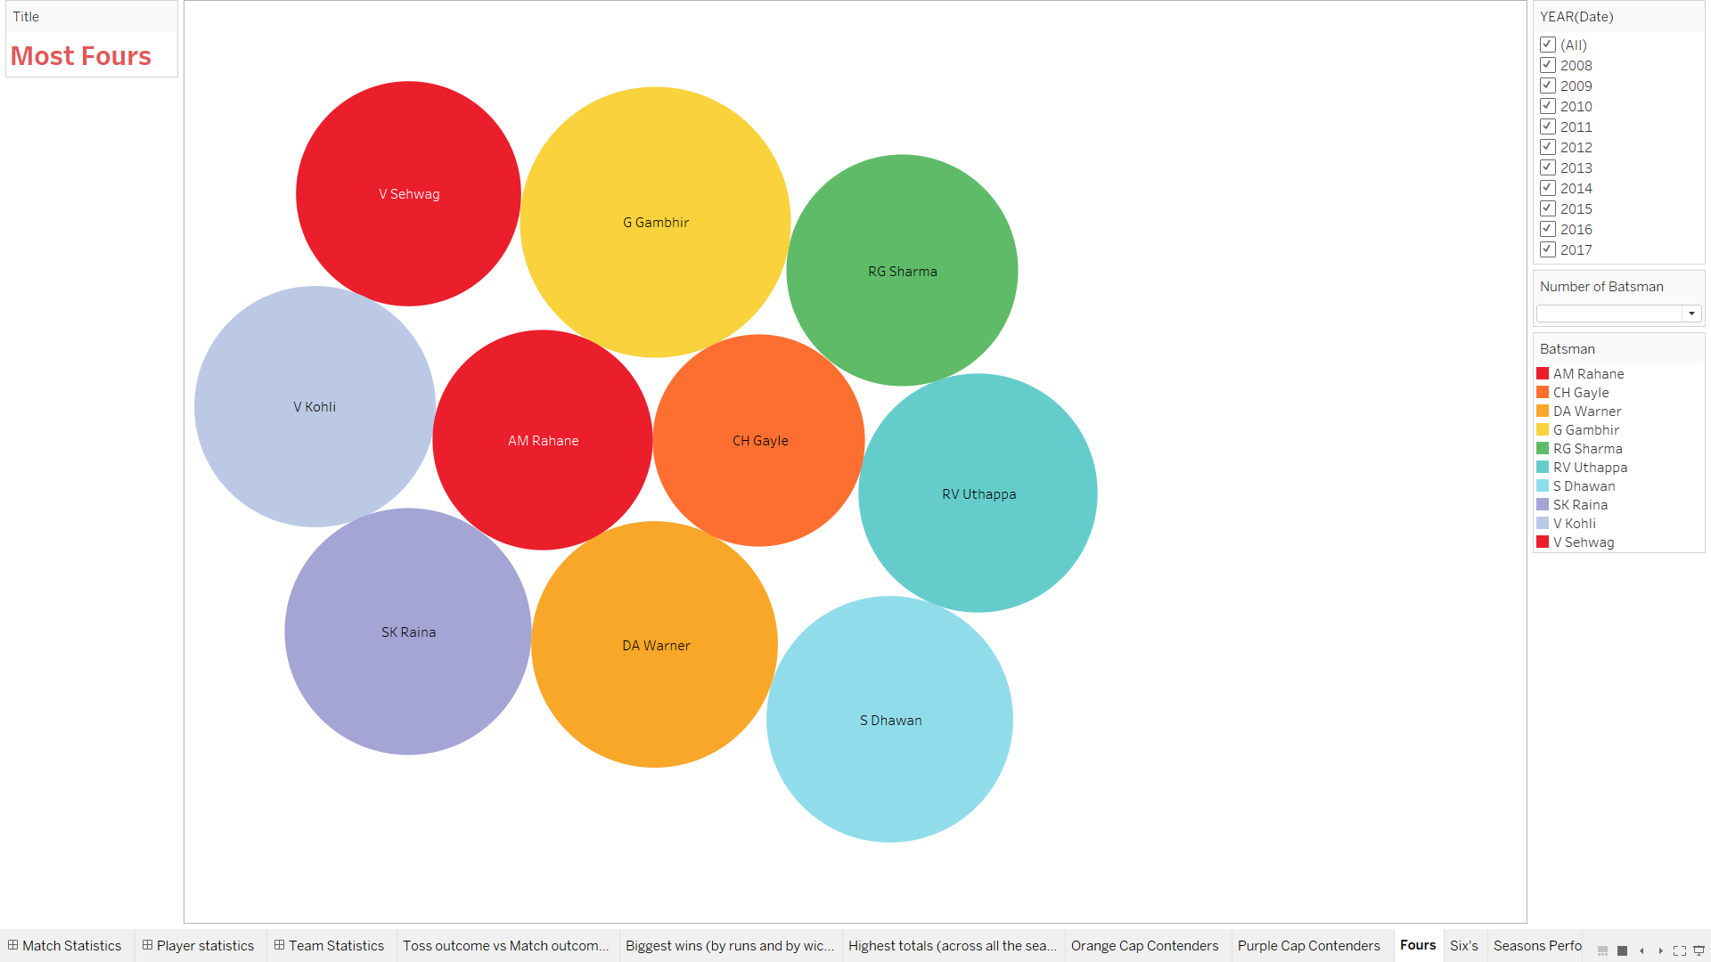
Batsmen who have hit the most number of 4’s in each season and overall
The visualization represents the batsmen who have taken the highest number of fours during a particular season from 2008 to 2017.
The data is filtered based on the year and the total number of batsmen who have achieved this.
Gambhir has hit the highest number of fours on average with 484 runs.

Slide 14
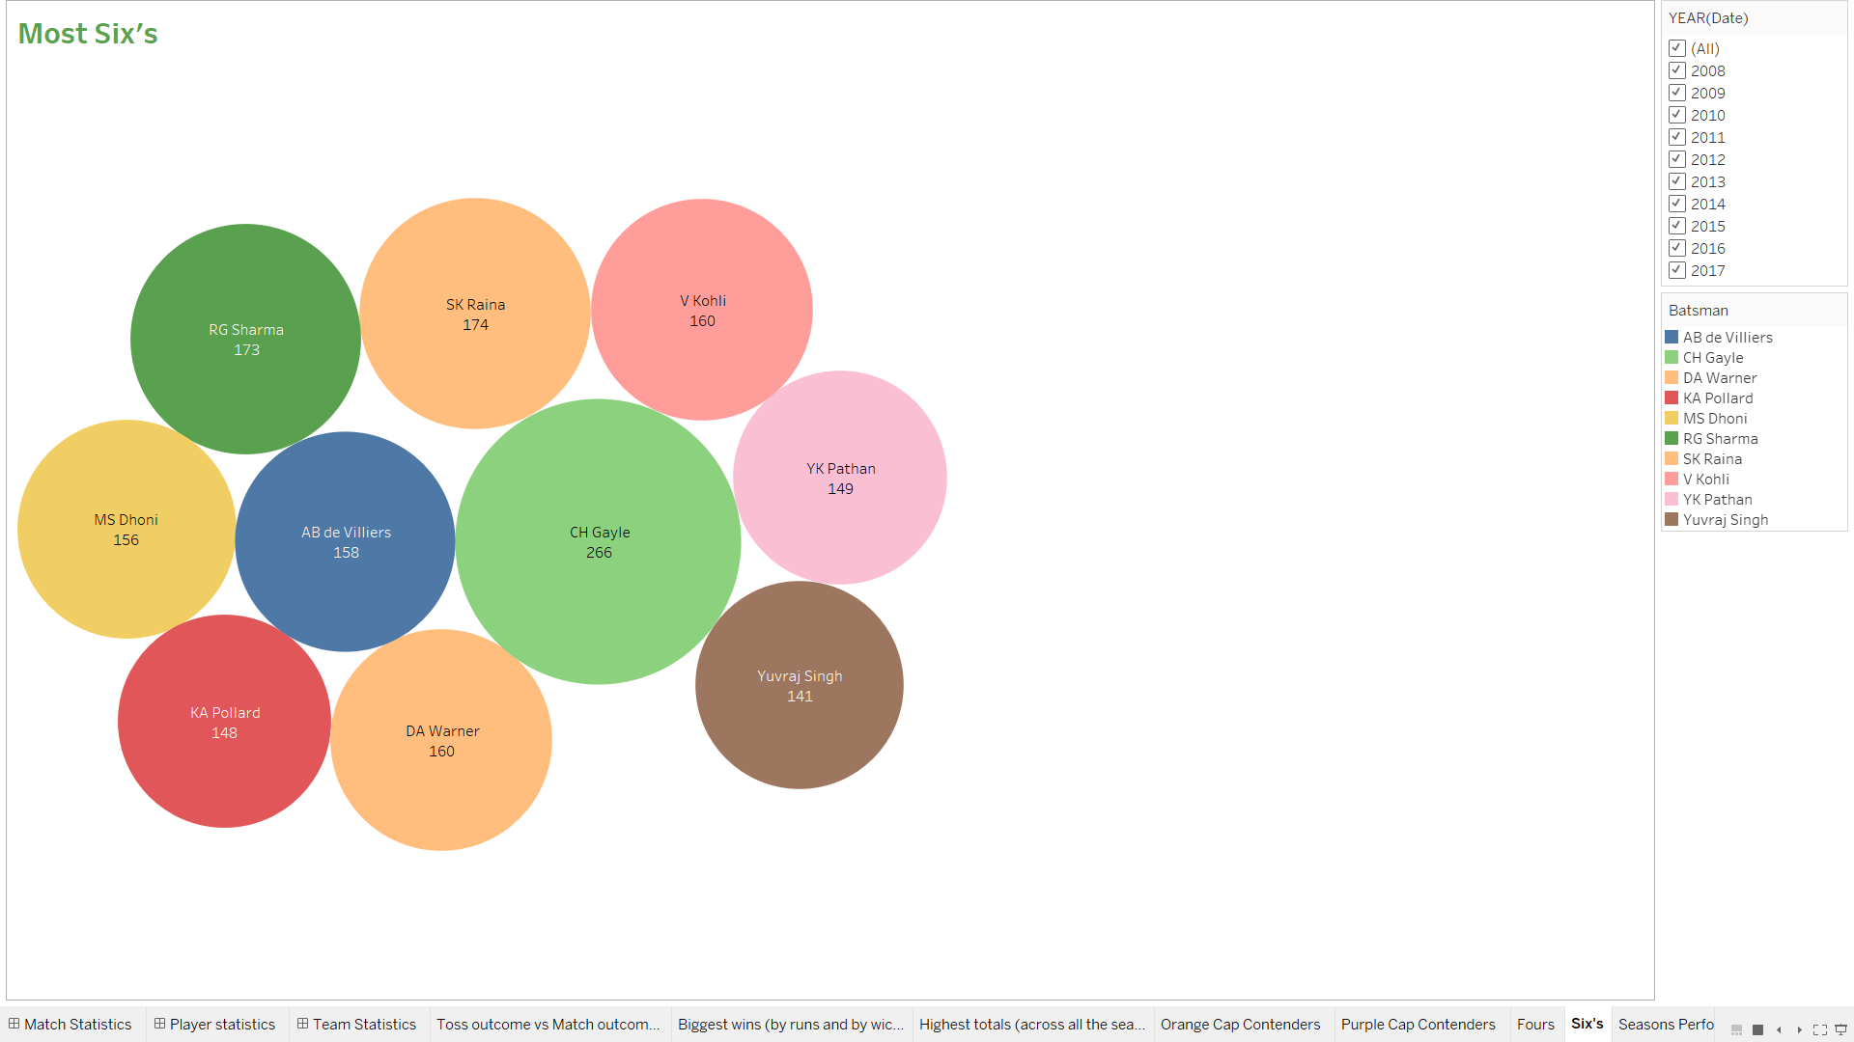
Batsmen who have hit the most number of 6’s in each season and overall
The visualization represents the batsmen who have taken the highest number of sixes during a particular season from 2008 to 2017.
The data is filtered based on the year and the total number of batsmen who have achieved this.
CH Gayle has hit the highest number of sixes on average with 266 each.

Slide 15
TEAM statistics
Season-wise team performance (wins vs losses)
Win % ( home vs away)

Slide 16
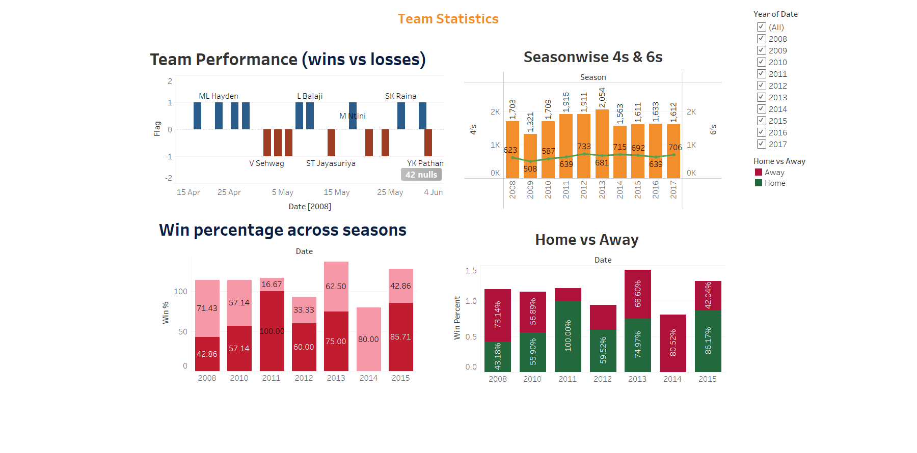
TEAM Statistics Dashboard

Slide 17
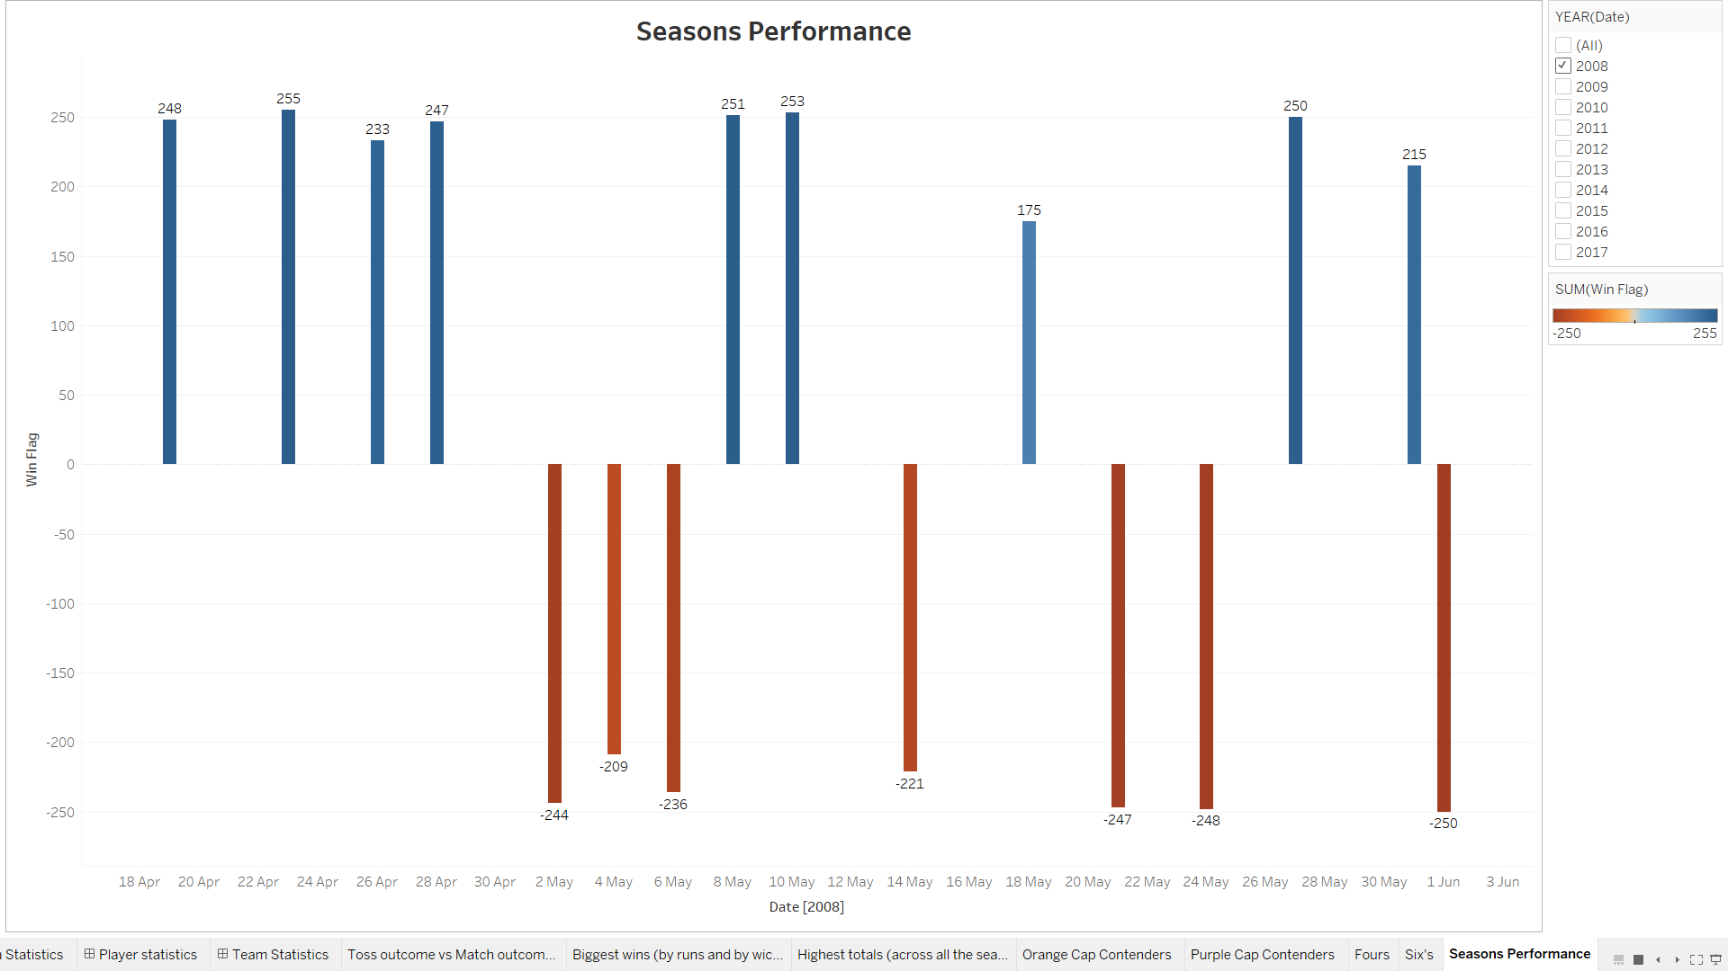
Team performance (wins vs losses)

Slide 18
SUMMARY
From this IPL Dataset, we were provided with 2 excel sheets, with information pertaining to matches and deliveries. This covered all aspects such as batsmen, bowlers, players who have scored the highest sixes and fours, each team that has performed well across all seasons from 2008 to 2016, and much more. We have analyzed all aspects of these data sets and created a visually interactive dashboard.

Slide 19
THANK YOU
Sara Ayoob

